Slide 1

TABLEAU DE BORD
BOROWSKI EKASSI MYKHAILO ALEXANDRE EMILIENNE YERMAKOV
PRODUCT OWNER TEAM MEMBER SCRUM MASTER

Slide 2
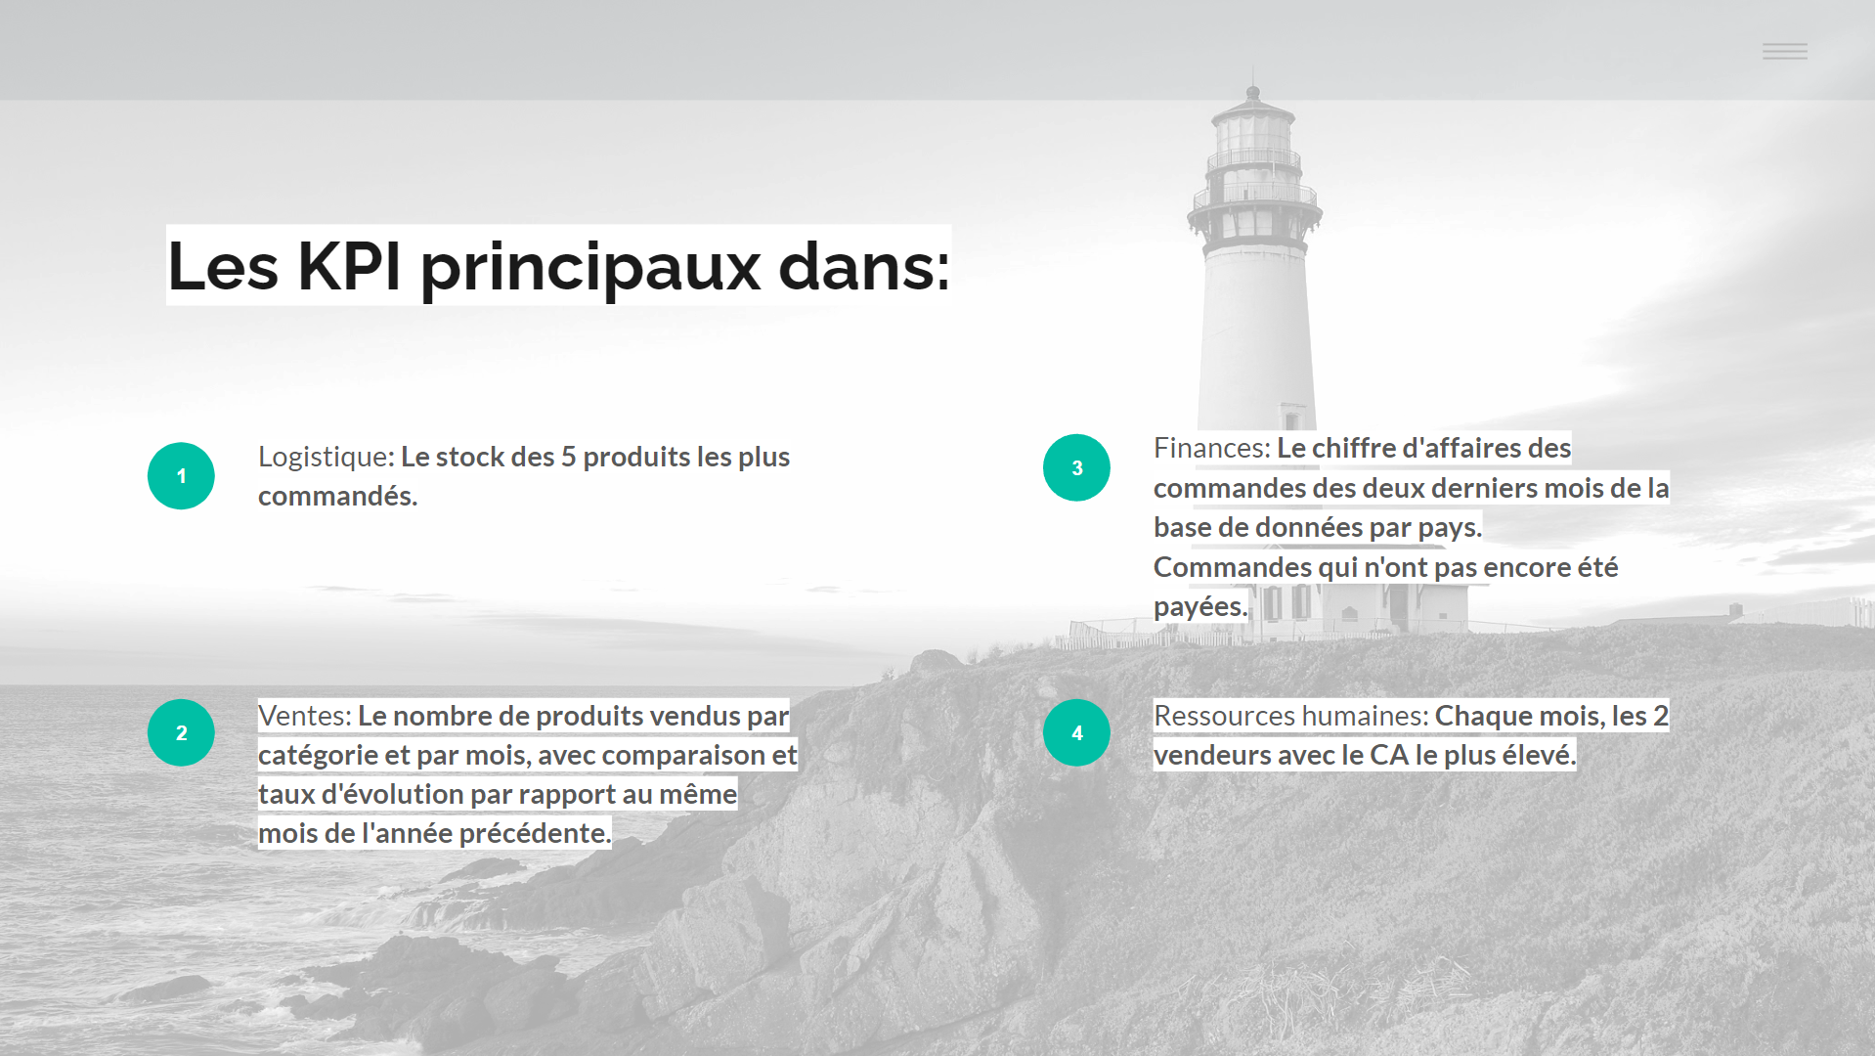

Slide 3
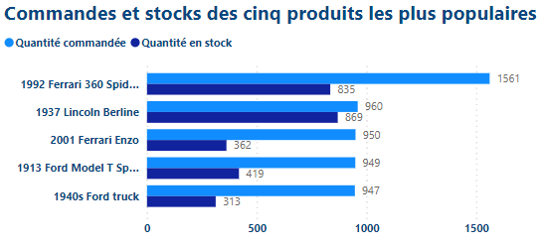

Slide 4
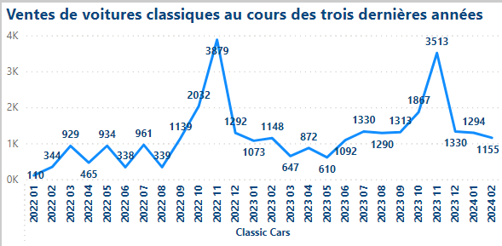

Slide 5
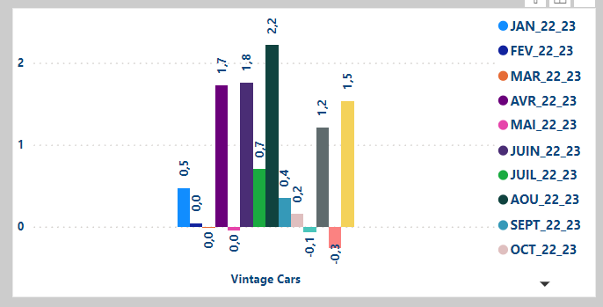

Slide 6
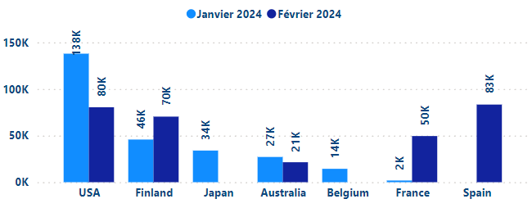

Slide 7
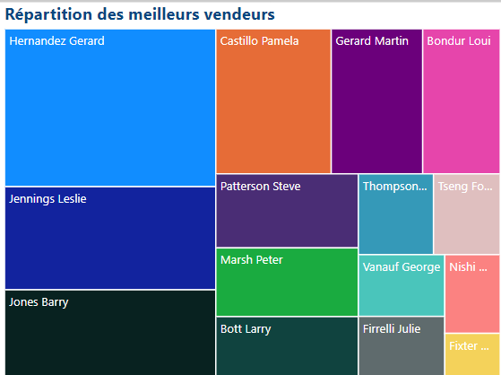

Slide 8
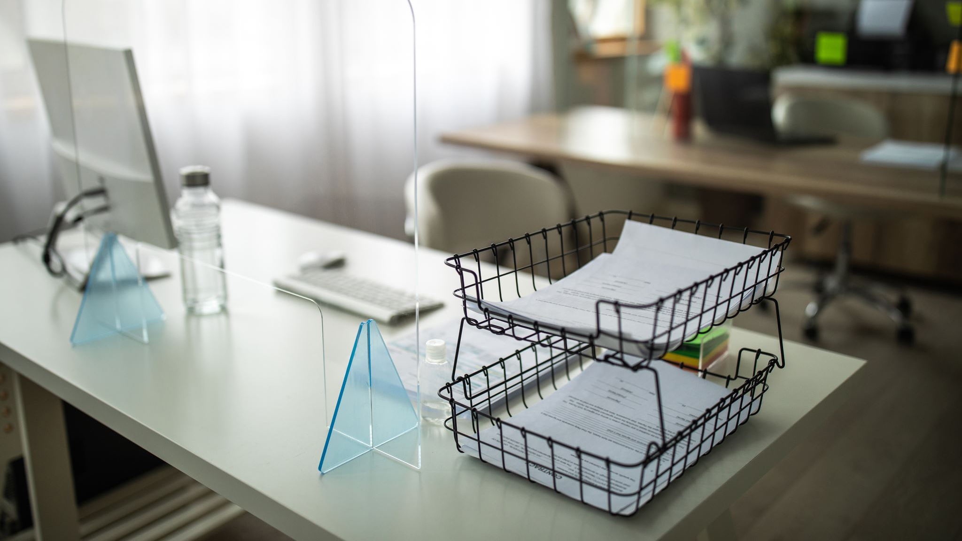
DEMO DU TABLEAU DE BORD

Slide 9

PROPOSITION

Slide 10






Slide 11

question

